Slide 2
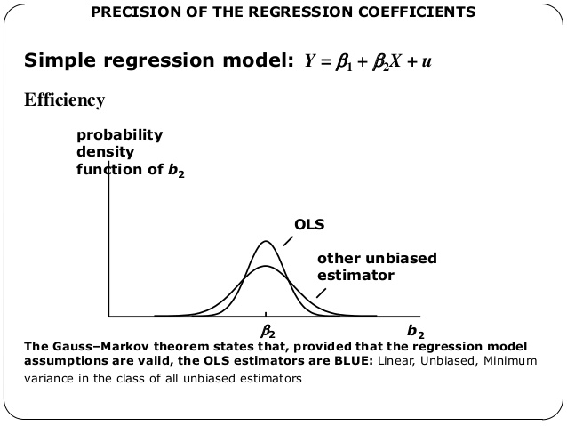
Gauss – Markov Theorem
Gauss – Markov Theorem: the ordinaly least squares (OLS) estimator is the best linear unbiased estimator. This means that the variance of the OLS estimator β2 has the lowest variance among the unbiased estimators.

Slide 3
Gauss – Markov Theorem
Gauss – Markov Theorem: the ordinaly least squares (OLS) estimator is the best linear unbiased estimator. This means that the variance of the OLS estimator β2 has the lowest variance among the unbiased estimators.
Why OLS is unbiased?
Why OLS has the lowest variance?

Slide 4
Bias – Variance tradeoff
Bias – Variance tradeoff: The quality of the model depends on wether it is capable of generalizing to other population samples or not. The generalization of a given model depends on the bias and variance of the estimators.
Bias → the source of error are erroneous assumptions between features and target outputs
Variance → the source of error is the sensitivity in the performance of the model to changes in the data set.
Factors that influenciate the capability of generalization of a model and its associate bias and variance quality measures are redundancy and irrelevancy.
We have shown that OLS is the best unbiased linear estimator
…. but is there a biased estimator that has lower variance than OLS?

Slide 5
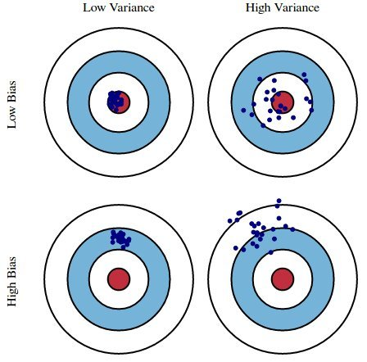
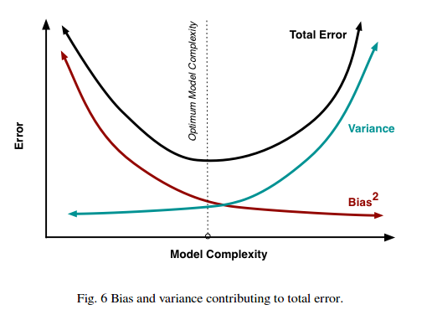
Bias – Variance tradeoff

Slide 6
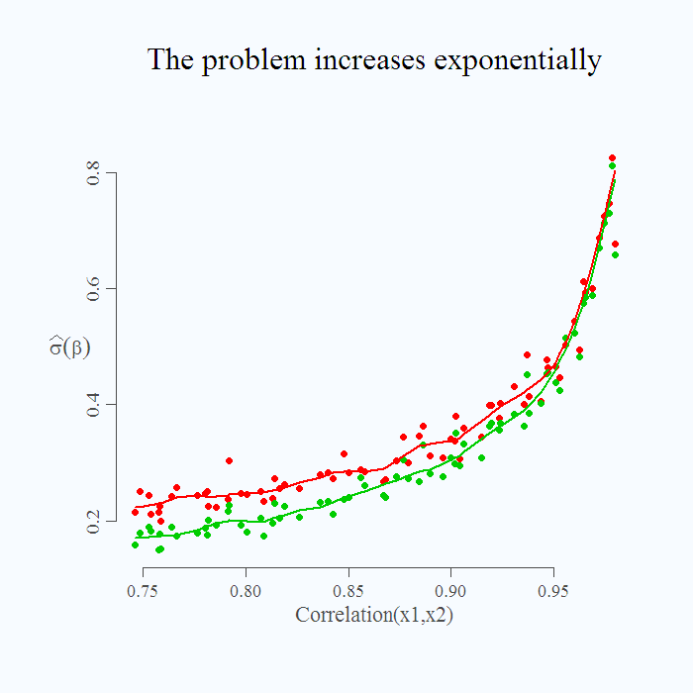
Bias – Variance tradeoff
Redundancy
If two predictors, X1 and X2,
are highly correlated,
Changes in X1 are not independent
of changes in X2
And the coeeficient estimators
are unstable…
Irrelevance
… adjusts to noise
We have shown that OLS is the best unbiased linear estimator
…. but is there a biased estimator that has lower variance than OLS?

Slide 7
Bias – Variance tradeoff
Unbiased estimators
OLS
Biased estimators
L1 penalty
L2 penalty
L1L2 penalty

Slide 8
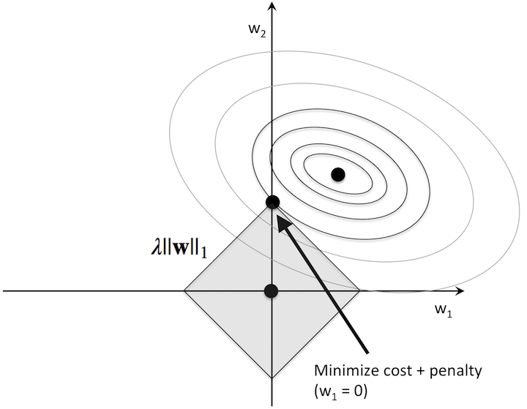
L1 regularization
Reduces the weights L1 – norm → stability
Performs a feature selection → interpretability
Analytical solution

Slide 9
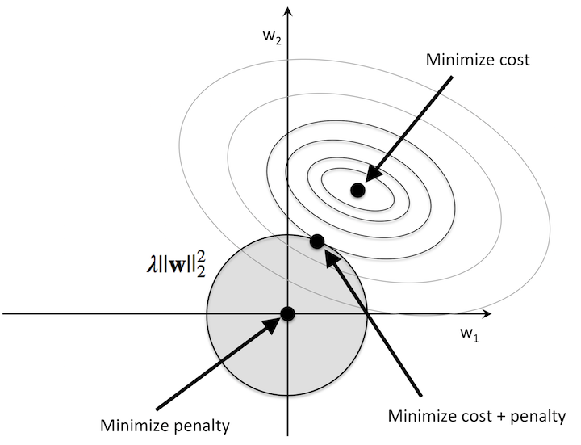
L2 regularization
Reduces the weights L2 – norm → stability
No feature selection
Numerical solution

Slide 10
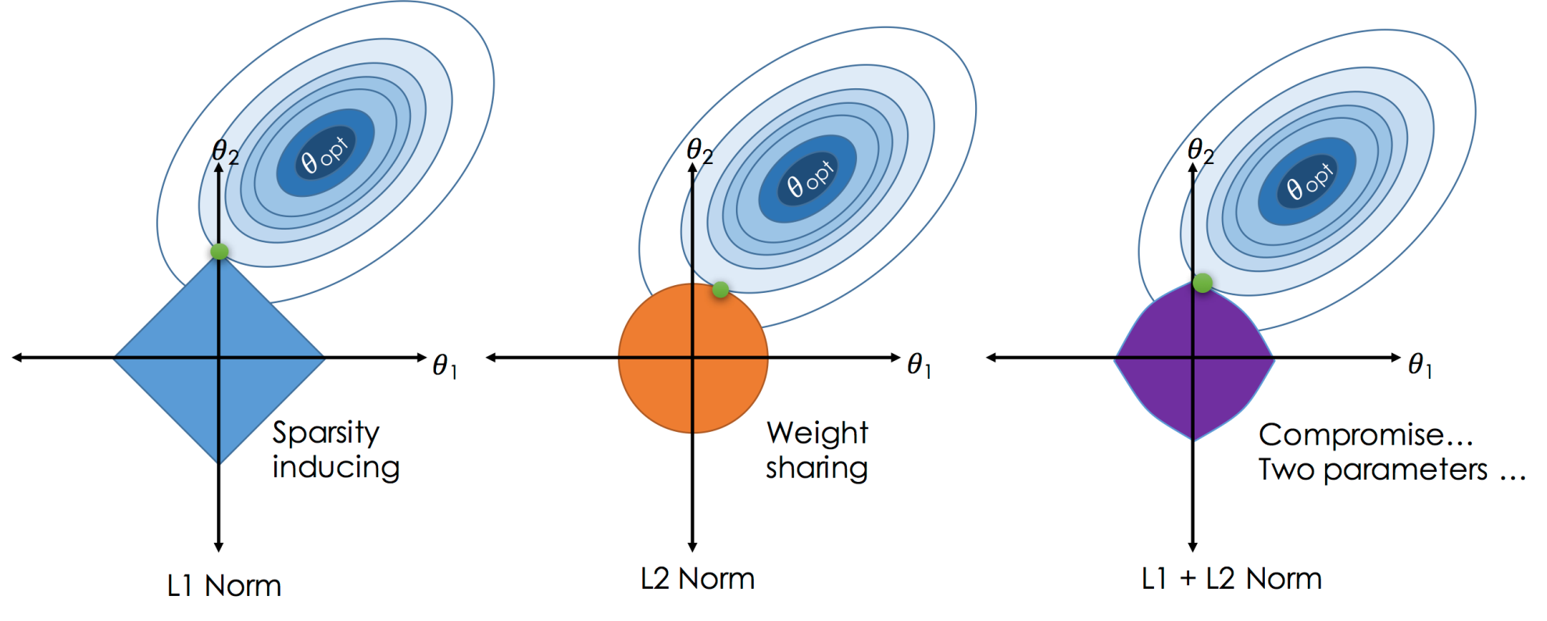
L1L2 regularization (elastic-net)
Combination of L1 and L2 norms.
If there is a group of highly correlated variables, then the LASSO tends to select one variable from a group and ignore the others. To overcome these limitations, the elastic net adds a quadratic part to the penalty .
Has a grouping effect on variables.

Slide 11
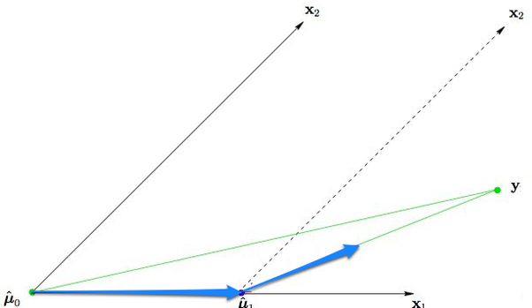
Least Angle Regression (LARS)
LARS: is an algorithm for fitting high-dimensional data to linear models. Typically there is redundancy and irrelevance among predictors and ideally we’d like to select a parsimonious model. LARS is an efficient way to perform variable selection in a linear model.
Modifications of LARS implements LASSO, stepwise regression and stagewise regression.
LARS computes LASSO estimates with an order of magnitud less of computational time.
Provides a LASSO interpretability of how it selects the predictors and how does it treats the coefficient estimates.

